Slide 1
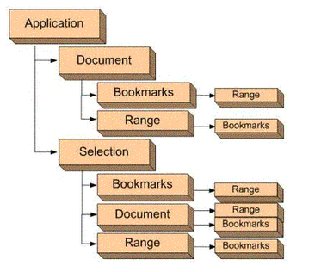
LLLL
jjjjjjjjjjjjjjjjjjjjj
上传的PPT

